Slide 1

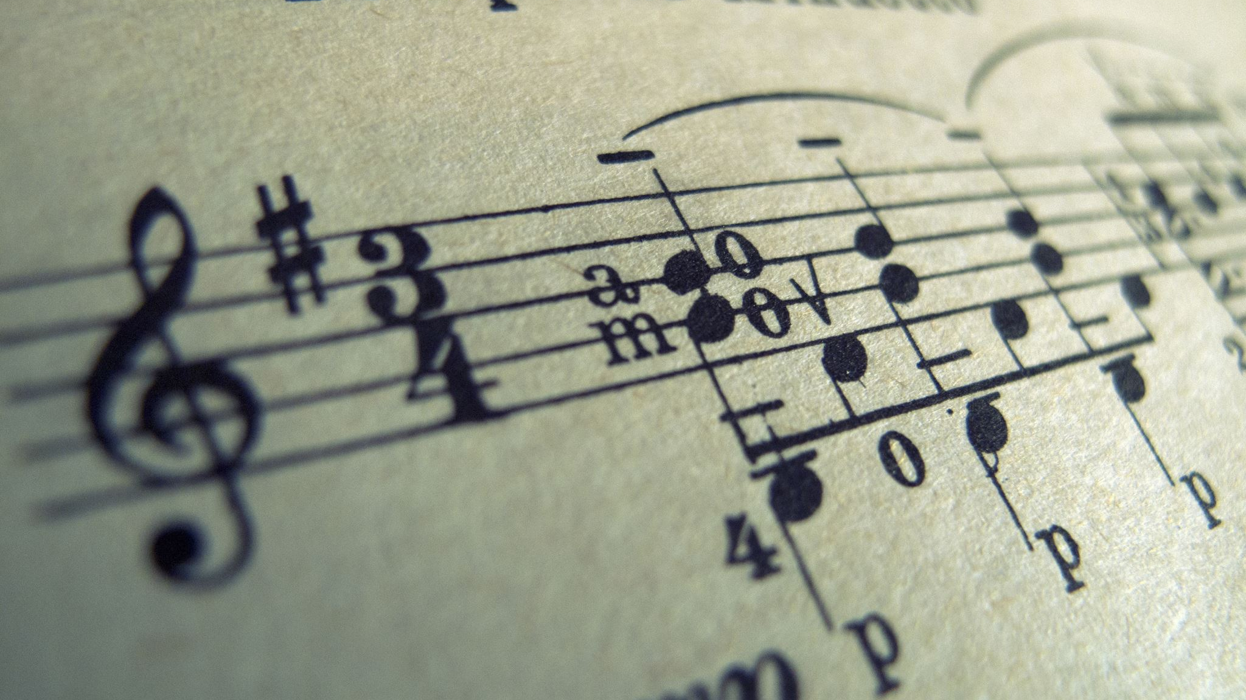
Music Genre Classification
2023
Abdulrahman Khalid
Sawsan Yusuf
Boshra Nasser

Slide 2

Goals
Build a model to predict the music Genre class using several machine-learning algorithms.
Evaluate each model predictions using F1-score.
Make submission with the best model .

Slide 3

Highlights
Prepare Data
Import
Explore
Split
Build Model
Iterate
Evalute
Results

Slide 4
Reading Dataset
Training dataset: 14,395 rows with 17 columns.
Column details: artist name, track name, popularity, danceability, energy, key, loudness, mode, speechiness, acousticness, instrumentalness, liveness, valence, tempo, duration in milliseconds, and time_signature.
Target Variable: Class.
Test dataset: 3,600 rows with 16 columns.

Slide 5
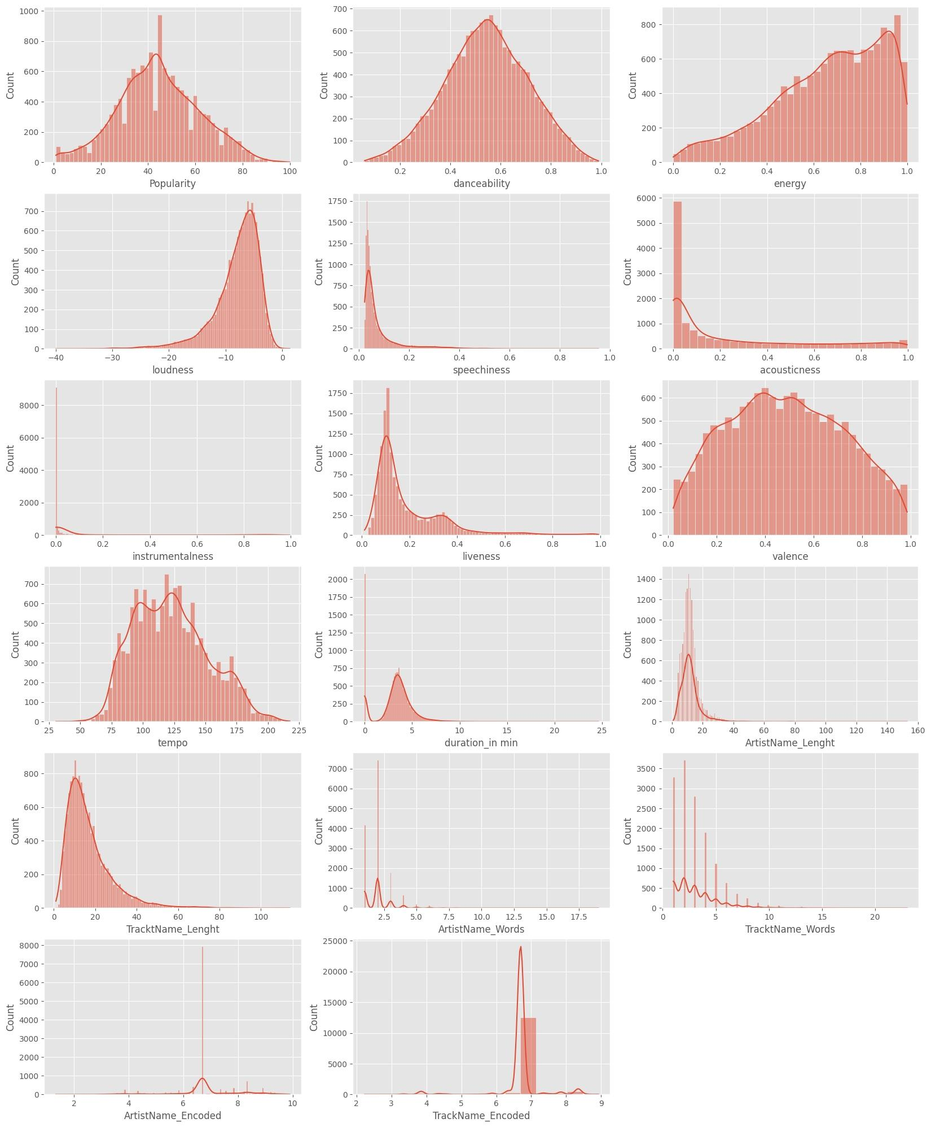
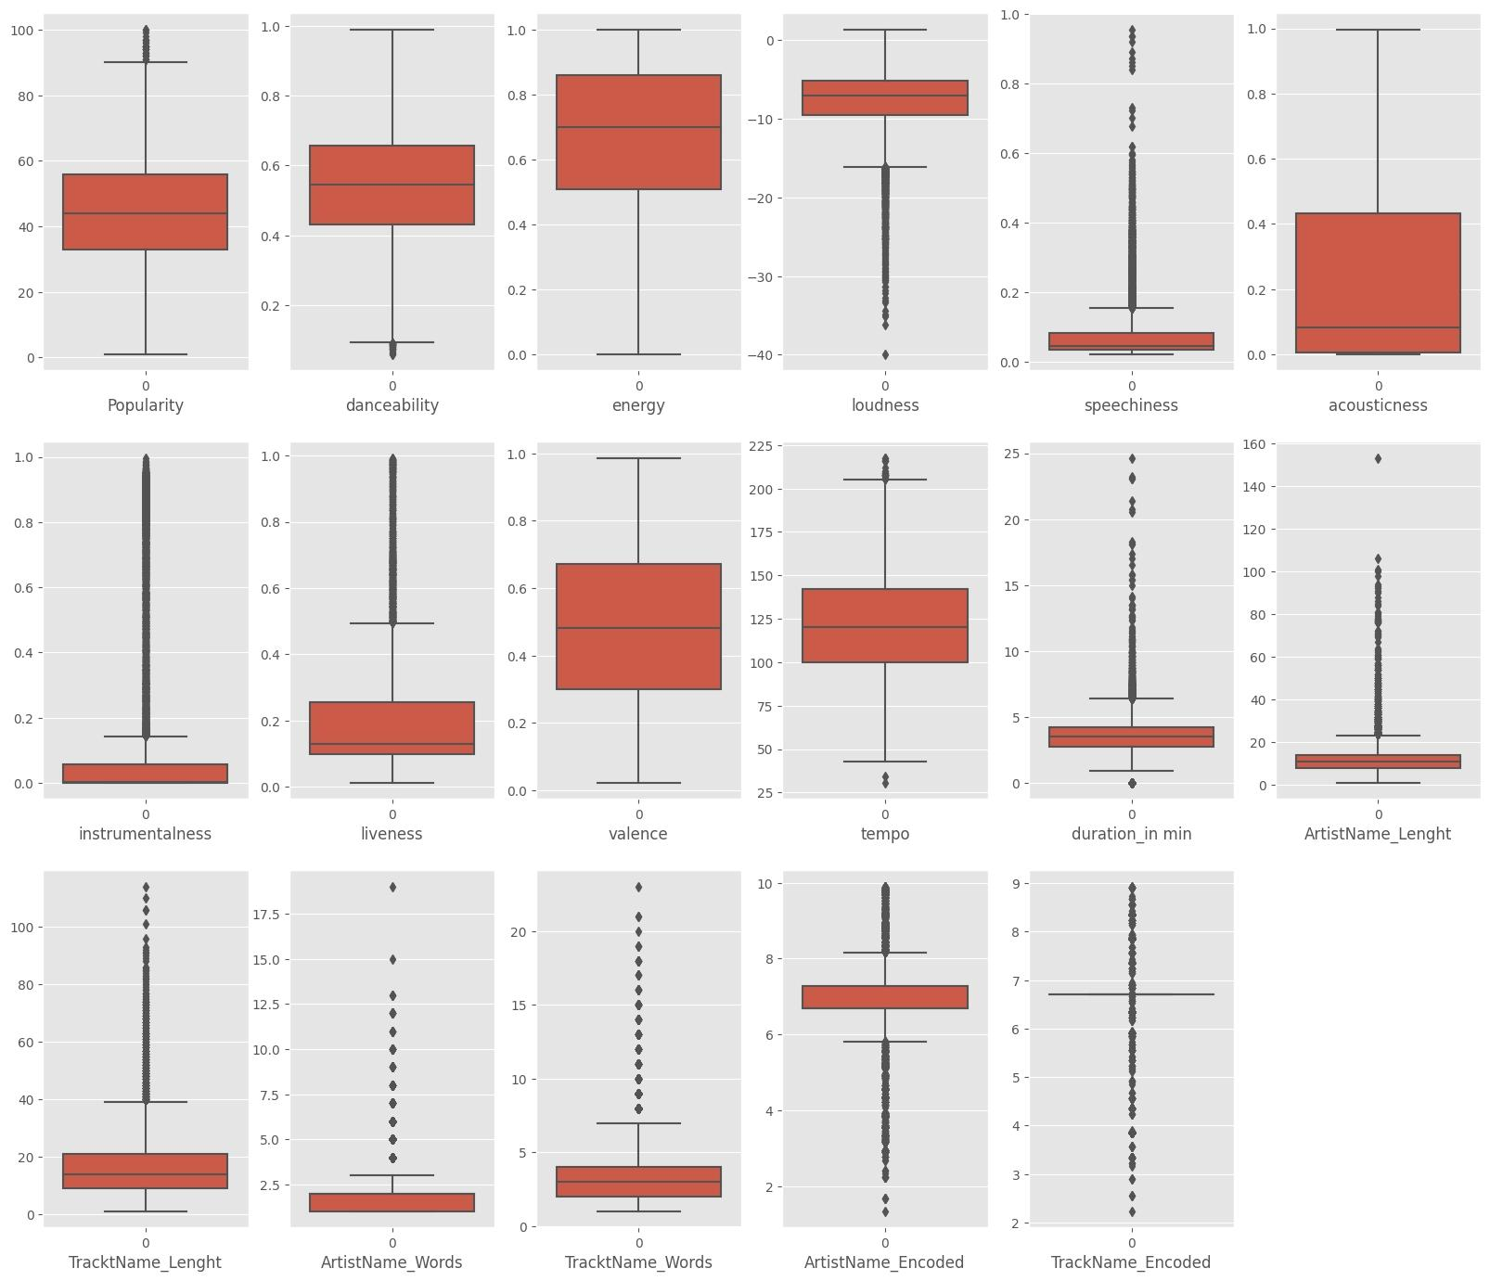
EDA
Univariate

Slide 6
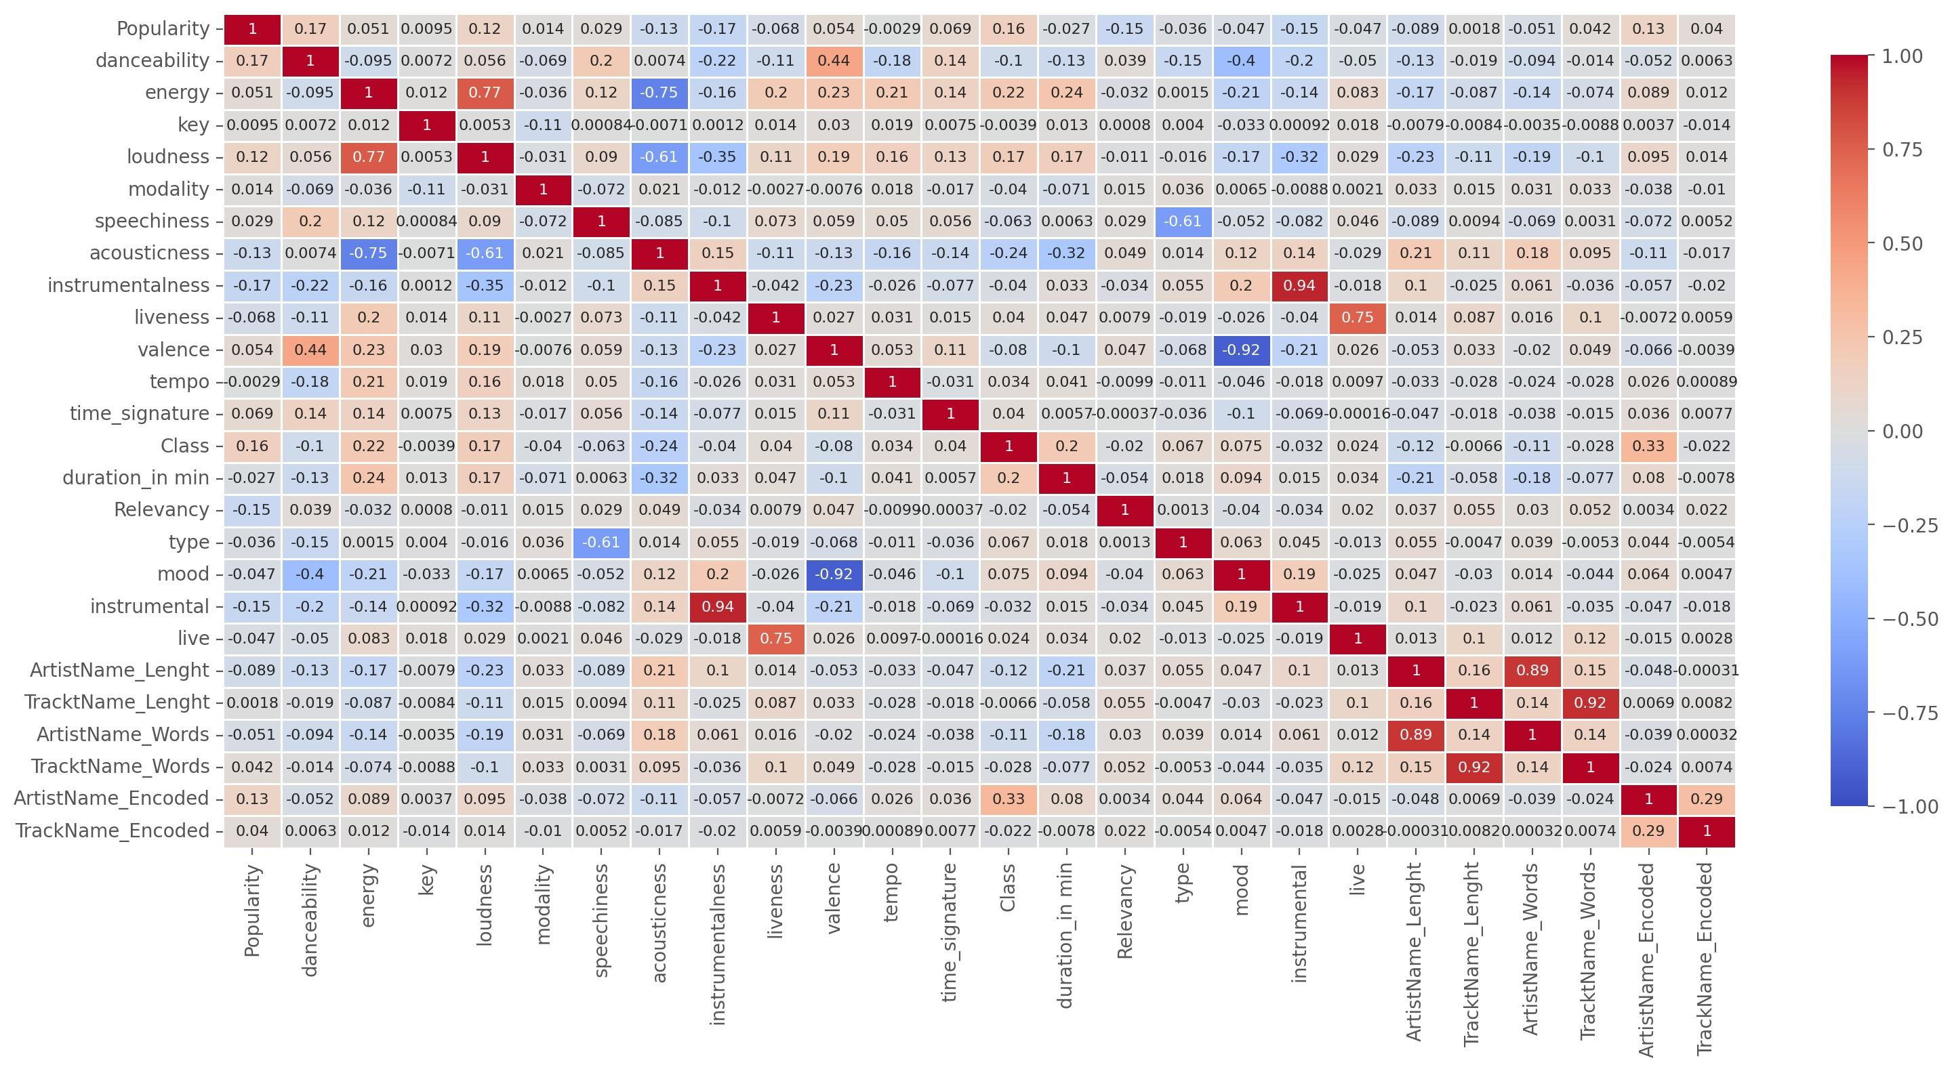
EDA
Multivariate

Slide 7
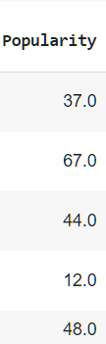


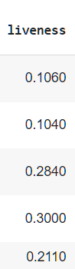

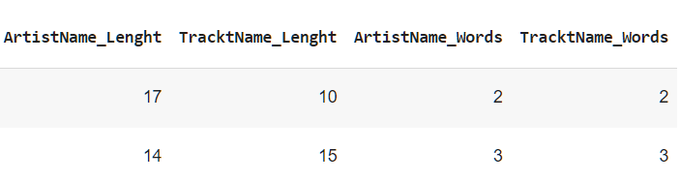
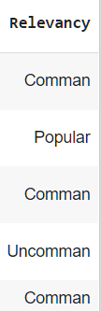
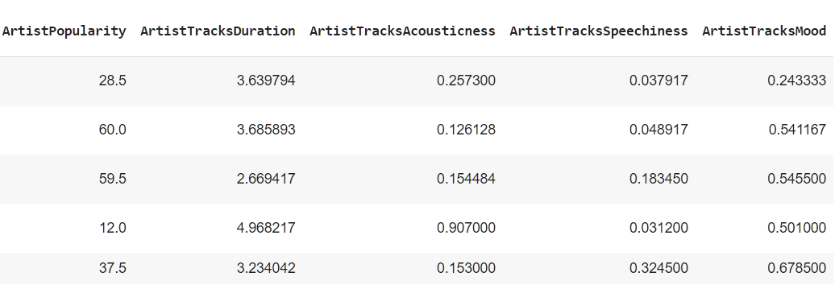
Feature Engineering
Since we have only 16 features to predict our track genre, So We tried to make new ones.
Binning numerical features could help make the data more linear.
Also Deriving more features from text features.
Along with grouping some features to derive new insights and aggregations.

Slide 8
Data Preprocessing
Removing Outliers
Features Log Transformation
Categorical Features Encoding
Preprocssing Pipeline
Data Splitting
Features Scaling

Slide 9
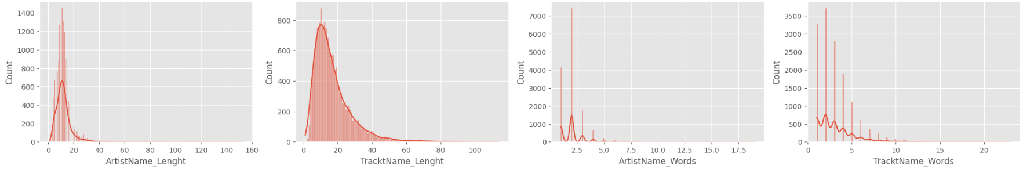
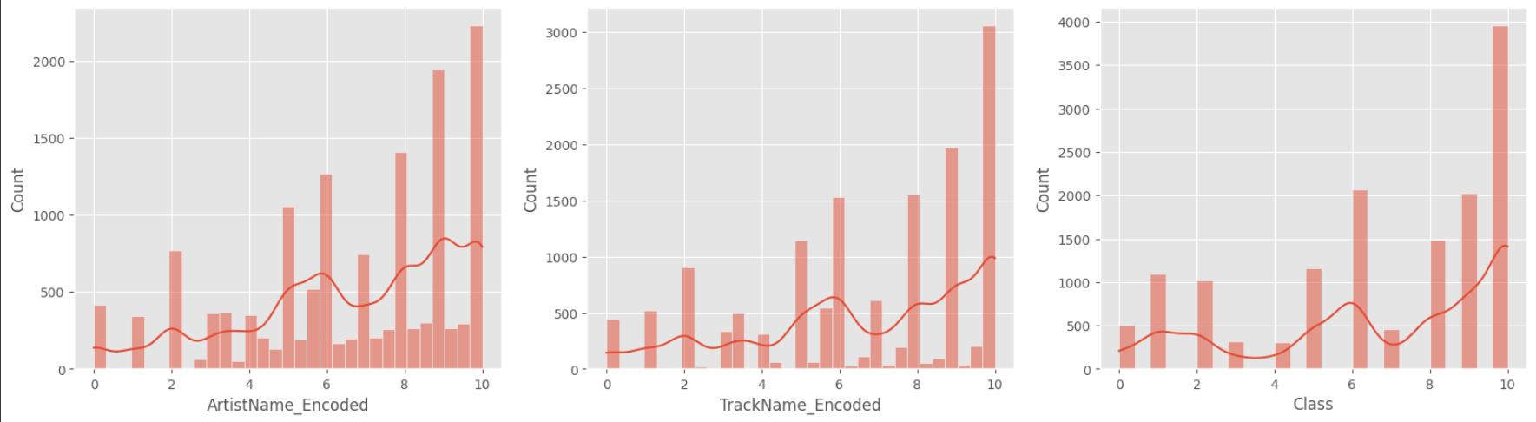
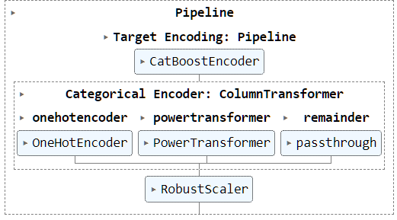
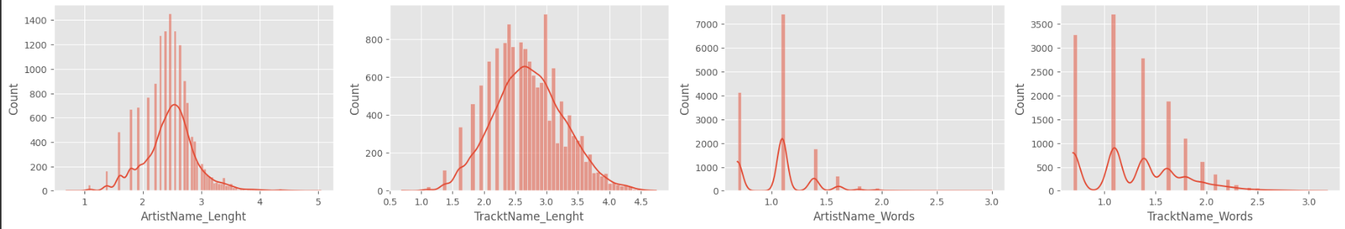
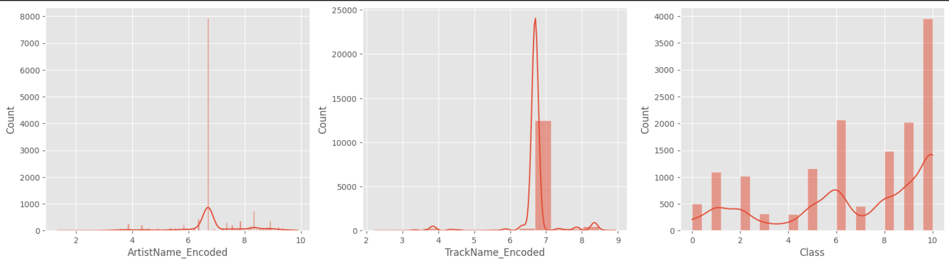
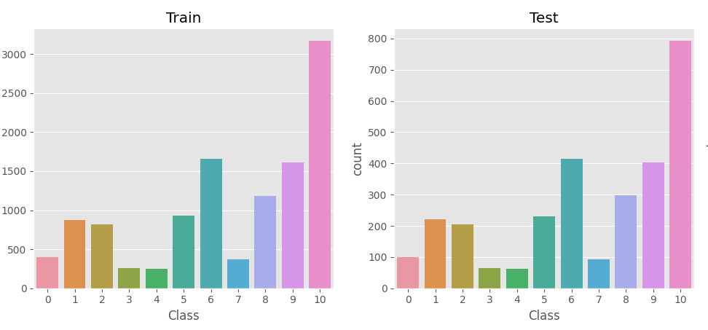
Data Preprocessing
Applying Log Transformation to our skewed features.
Features Scaling with `Robust Scaler` that is prone to outliers.
Using Target Encoding to encode our high cardinality categorical features.
Combining all these steps in a preprocessing pipeline.
Splitting Data with Stratify to preserve classes distribution.

Slide 10




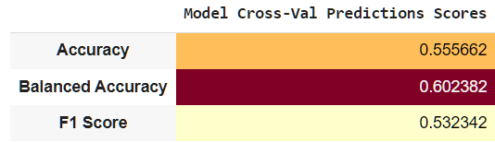
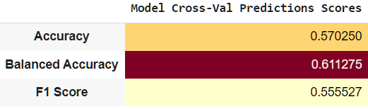
Model Building
Traditional Models
LR
KNN
SVM
MLP
At First, we tried Traditional ML Models.
Logistic Regression and MLP Classifiers seemed to give good performance.

Slide 11




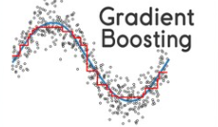
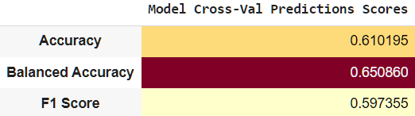
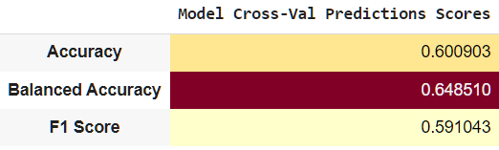

Ensemble and Boosting Models
We tried several ensembles and boosting techniques.
And found out that gradient boosting with its variants are giving the best performance.

Slide 12
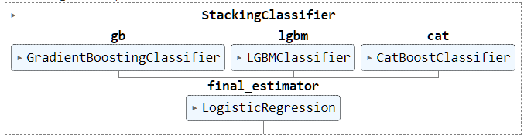
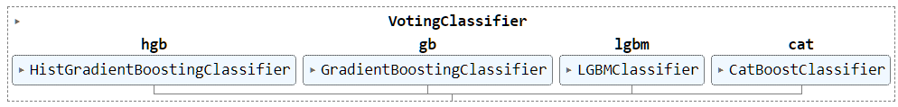
Fine-Tuning and Boosting Best Models
LR
MLP
We Fine-Tuned our best performing models with Grid Seach for best hyperparameters.
Then we tried to boost their performance with Stacking and Voting Techniques.

Slide 13
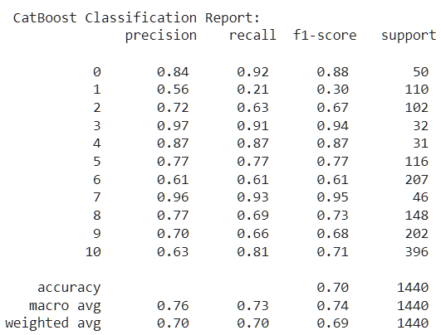
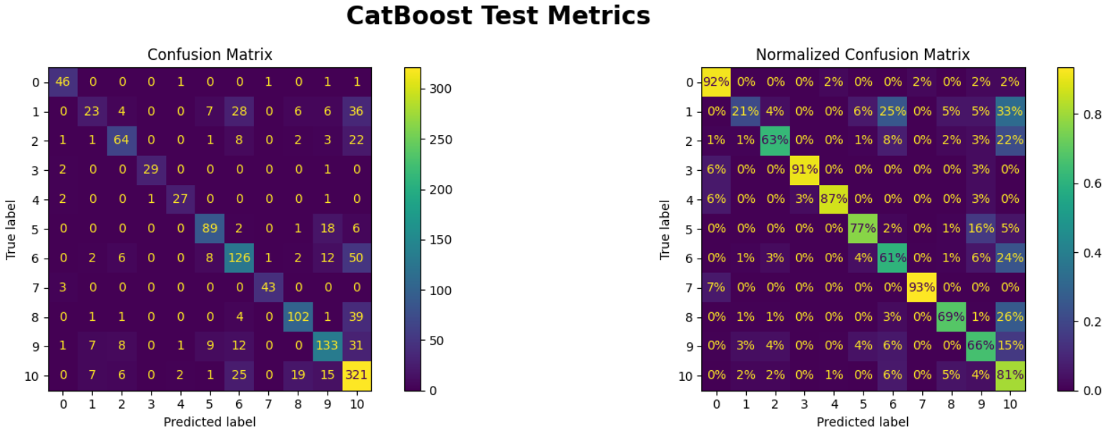
Cat Boost Modeling
At First, We trained CatBoost the same way we trained our models with our encoding of the categorical features.
But CatBoost Library gives the option to let Catboost encode those categorical with its own encoding technique while training.
This Training Technique gave outstanding performance compared to any model we trained.

Slide 14
Conclusion & Discussion
Kaggle Public Score
Kaggle Private Score

